Slide 1
The Lego Exception:
A peek behind the legislative carve-out for modular systems

Slide 2
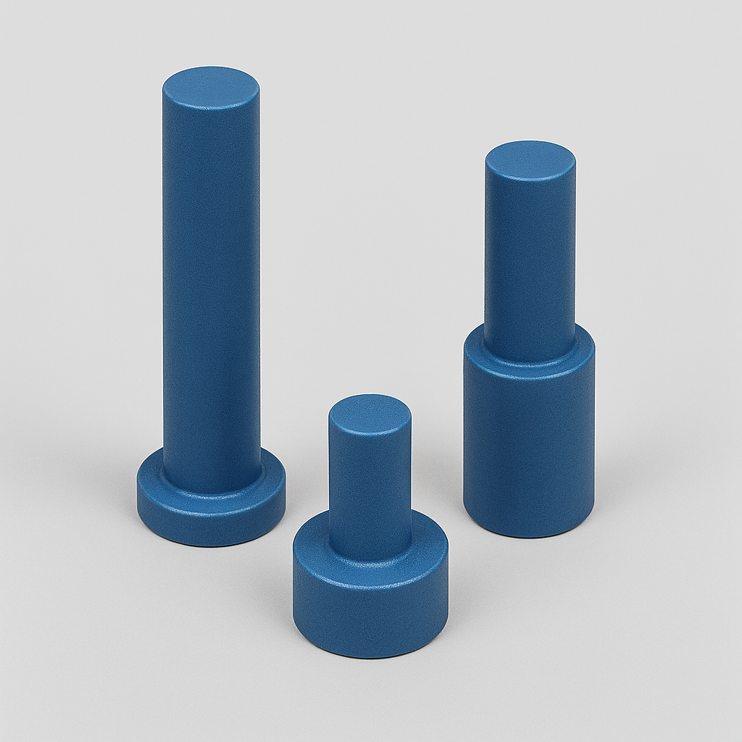
Legal background
Article 8(1): no protection for features solely dictated by technical function
  A feature is excluded only if technical function is the only factor that determines its appearance.
AI‑generated illustrative schematic of a purely functional industrial component, used to explain the DOCERAM methodology under Article 8(1) CDR

Slide 3

Legal background
Article 8(2): no protection for features that must be reproduced exactly to permit connection with another product (must-fit)
  No designer’s freedom
Distinct from modular system (Article 8(3)
Internal USB 3.0 Motherboard Adapter. Source: NTC Distributing

Slide 4

What is the Lego exception?
©2026 The LEGO Group. All rights reserved
Article 8(3): despite Article 8(2), protection can exist for designs allowing multiple assembly or connection of interchangeable products within a modular system
  As long as they comply with Articles 5 & 6
©2026 The LEGO Group. All rights reserved

Slide 5
Articles 5 & 6
Article 5: Novelty
A design shall be considered to be new if no identical design has been made available to the public
Designs shall be deemed to be identical if their features differ only in immaterial details.
Article 6: Individual character
A design shall be considered to have individual character if the overall impression it produces on the informed user differs from the overall impression produced on such a user by any design which has been made available to the public
In assessing individual character, the degree of freedom of the designer in developing the design shall be taken into consideration.

Slide 6
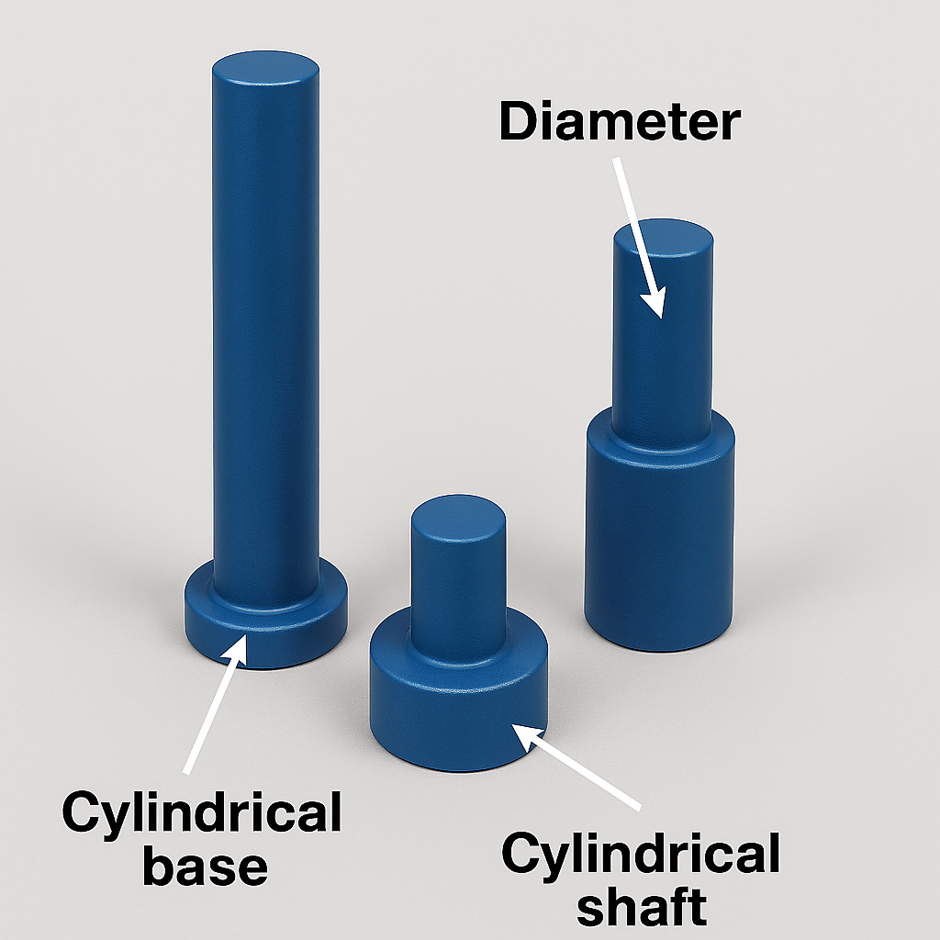
DOCERAM
C-395/16 DOCERAM v CeramTec
  Baseline test for Article 8(1) CDR
  (technical function)
  The existence of alternative designs is not decisive
  Defines the boundary between functional exclusions and the modular exception
AI‑generated illustrative schematic of a purely functional industrial component, used to explain the DOCERAM methodology under Article 8(1) CDR

Slide 7
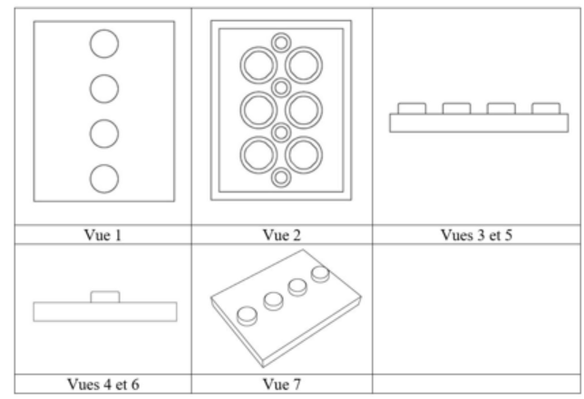
LEGO v EUIPO
T-515/19 LEGO
  First LEGO case concretising Article 8(3) CDR (modular exception)
  Interconnecting features may remain protectable
  Relationship between Articles 8(1) CDR (technical function) and 8(3) CDR (modular exception)
RCD No. 001664368-0006 “Building blocks from a toy building set” (LEGO)

Slide 8
Delta Sport v EUIPO – LEGO
T-537/22 (Follow-up to T-515/19 after remittal)
  Concrete application of Articles 8(1)-(3) CDR
  Functionality does not prevent Article 8(3) from applying
  Design invalid only if all features are excluded
RCD No. 001664368-0006 “Building blocks from a toy building set” (LEGO)

Slide 9
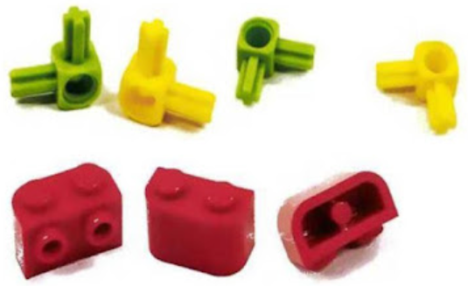
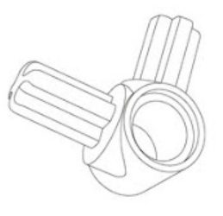
CJEU ruling
C-211/24 LEGO A/S v Pozitív Energiaforrás Kft.
  Enforcement context for Article 8(3) CDR
  Scope of protection assessed via the “informed user”
  Courts cannot deny remedies based on limited infringement

Slide 10
Why it matters
  Preserves protection for modular industries
  Creates a targeted exception to the technical function exclusion
  Balances competition and innovation

Slide 11

Thank you for your time
Paula de Andrés Gómez
European Design Attorney, International Client Relations (Designs), Head of Alicante office, Trademark Consultant
paula.deandresgomez@berggren.es
+358 40 553 5702 (FI)
+34 659 63 61 95 (ES)

Slide 12
https://www.berggren.eu/en/

